Slide 1


On-Chain
DEX AGGREGATOR
CSCD71 Final Project

Slide 2
Decentralized Exchanges (DEXs)
DEXs have revolutionized crypto trading through peer-to-peer transactions.
However, the increasing number of DEXs causes fragmented liquidity having the following effects:
Makes it challenging for users to get the best prices
Harder to minimize slippage
Solution:
DEX Aggregators as a platform to unify liquidity from multiple DEXs.
Notes:
Decentralized Exchanges (DEXs) have revolutionized cryptocurrency trading by enabling peer-to-peer transactions. However, the increasing number of DEXs has led to fragmented liquidity, making it challenging for users to find the best prices and minimize slippage . DEX aggregators have emerged as a solution to this problem, providing a unified platform to access liquidity from multiple DEXs .

Slide 3
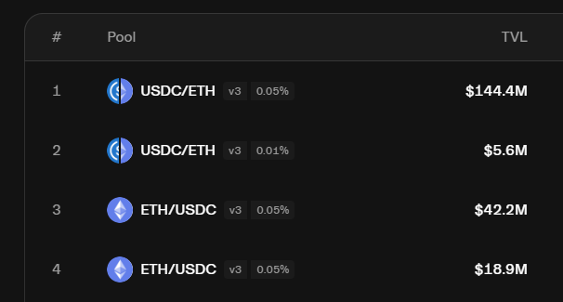
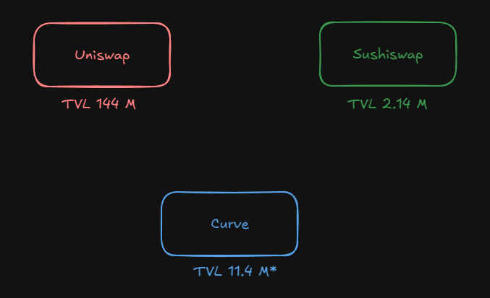
Fragmented Liquidity
Uniswap
Other DEXs

Slide 4
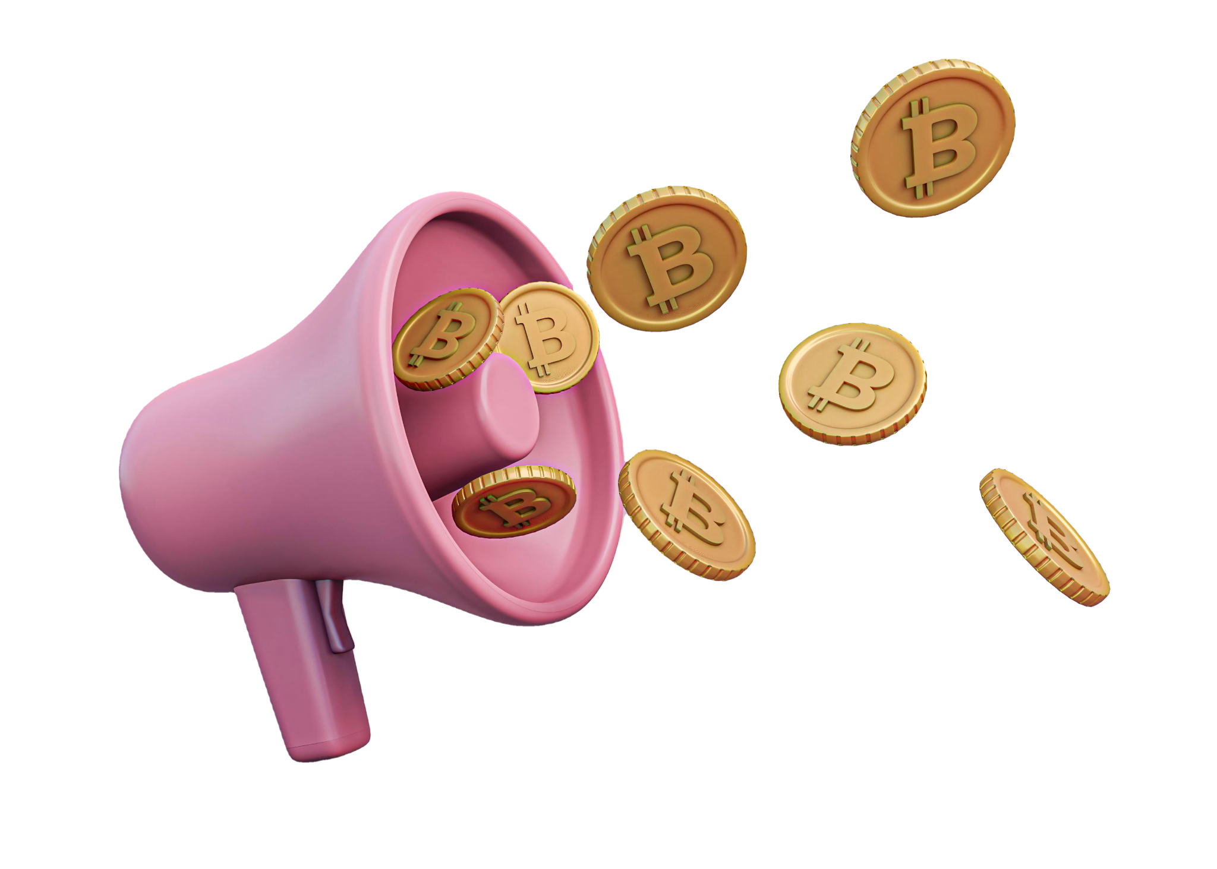
DEX Aggregators
DEX aggregators act as a "shopping assistant"
Pulls data from multiple DEXs
Similar to flight comparison websites work
Consolidates liquidity from the different pools to optimize trades for the end user
Finds best token swap rate
Accounts for slippage
Notes:
They pull data from various decentralized exchanges, similar to how flight comparison websites search different airlines for the best deals . By consolidating liquidity from multiple sources, aggregators aim to offer users better token swap rates and optimize their trades .

Slide 5

Architecture
The architecture of a DEX aggregator relies on gathering data from various sources in real-time, including:
On-chain data: Directly from blockchain nodes to track liquidity pool sizes and real-time pricing .
DEX APIs: Provided by individual DEXs, offering price feeds and other valuable information .
Price oracles: For accurate and up-to-date price data .
This data is then processed and transformed into a format suitable for the aggregator's routing algorithms .
Notes:
The architecture of a DEX aggregator relies on a robust data aggregation system . This system gathers information from various sources in real-time, including:
On-chain data: Directly from blockchain nodes to track liquidity pool sizes and real-time pricing .
DEX APIs: Provided by individual DEXs, offering price feeds and other valuable information .
Price oracles: For accurate and up-to-date price data .
This data is then processed and transformed into a format suitable for the aggregator's routing algorithms .

Slide 6

Aggregators VS DEX
Why people still use UniSwap instead of DEX’s

Slide 7
DEX Advantages | Dex Aggregator Advantages
More gas-efficient (fewer contract calls) | Finds best price across multiple DEXes
Simpler execution logic (less code, easier to audit) | Smart routing reduces slippage on large trades
No reliance on external APIs or off-chain systems | Access to deeper and fragmented liquidity

Slide 8
Smart Order Routing Algorithms
01
Slippage
02
Gas Costs
03
Token Pairs and Liquidity
04
Transaction Speed
Able to get real-time prices during trade execution and could split orders across pools.
Weighing the trade-off between price and gas fees to choose the most cost-effective route.
Aware of available liquidity of trading pairs on each DEX and adjusting the routing accordingly.
Can optimize transaction speed using parallelizing or batching techniques.

Slide 9
How Smart Routing Works?
Query DEXs
Optimize Swap
Create Route
Query or use an oracle for each DEX to find their swapping rates.
Splitting a single trade across multiple DEXs or liquidity pools to minimize slippage and price impact.
Considering gas costs to ensure the chosen route provides the best net outcome for the user.

Slide 10
Benefits of Using Dex Aggregators
Better Prices: By aggregating liquidity from multiple DEXs, aggregators can often find the best available prices for token swaps .
Reduced Slippage: Splitting orders across various liquidity sources helps to minimize the impact of large trades on price .
Increased Liquidity: Aggregators provide access to deeper liquidity pools across different exchanges, improving the chances of successful trade execution, especially for large orders .
Convenience: Users can access multiple DEXs through a single, user-friendly interface, simplifying the trading process .
Gas Optimization: Some aggregators implement techniques to reduce gas fees, such as transaction batching and finding gas-efficient routes .

Slide 11
Considerations
Security is important whenever dealing with the swapping and exchange of user funds with common concerns being:
Front-running attacks: Malicious actors exploiting pending transactions
Smart contract vulnerabilities: Coding errors or logic flaws in the aggregator's or underlying DEXs' contracts
Oracle manipulation: If price feeds are compromised, leading to incorrect trade executions

Slide 12
GAS OPTIMIZATION TECHNIQUES
Efficient smart contract design: Minimize complexity and optimize gas
Transaction batching: Grouping transactions, reducing overhead
Leveraging gas tokens: Using tokens that can be redeemed to offset gas costs
Exploring Layer-2 solutions: Utilizing scaling solutions to reduce gas fees on the main blockchain

Slide 13
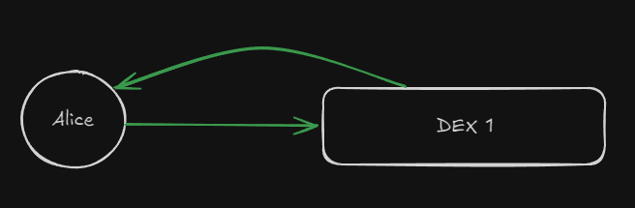
Example: Normal Swap

Slide 14
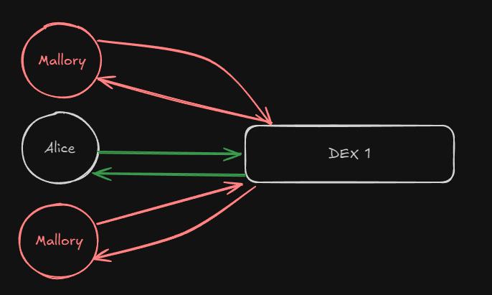
Example: Sandwich Attack

Slide 15
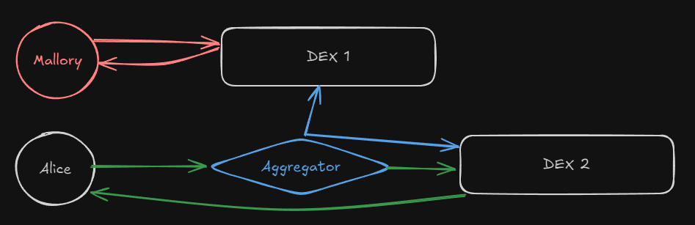
Example: Sandwich Attack w/ Aggregator

Slide 16
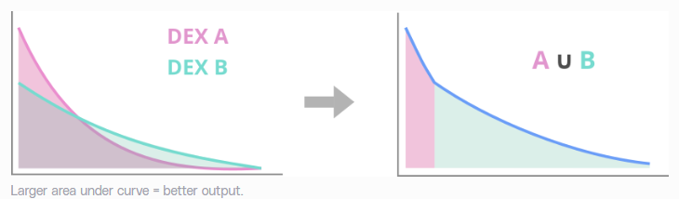
Better Swap Prices

Slide 17
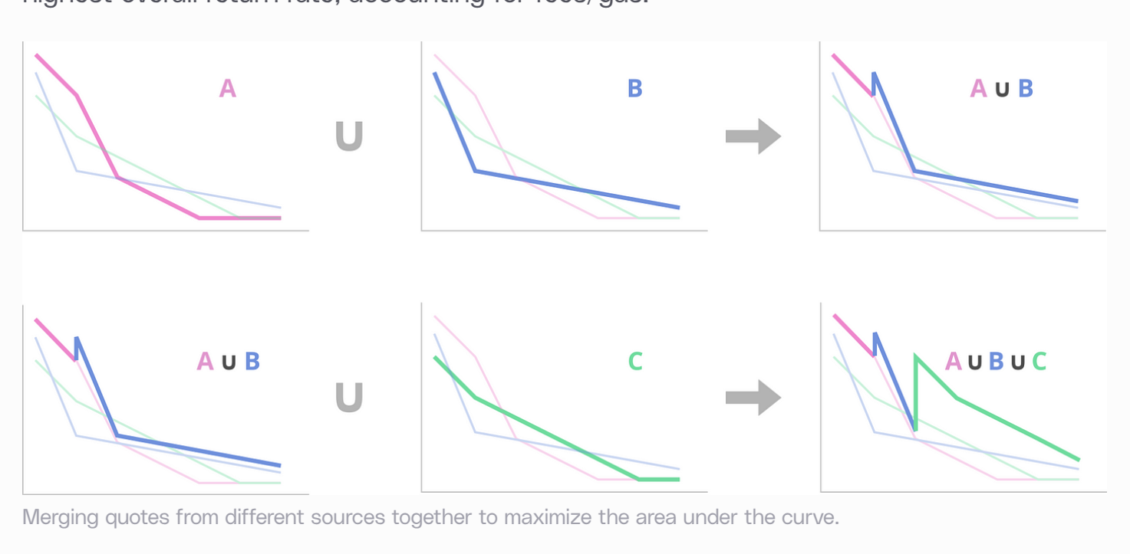

Slide 18
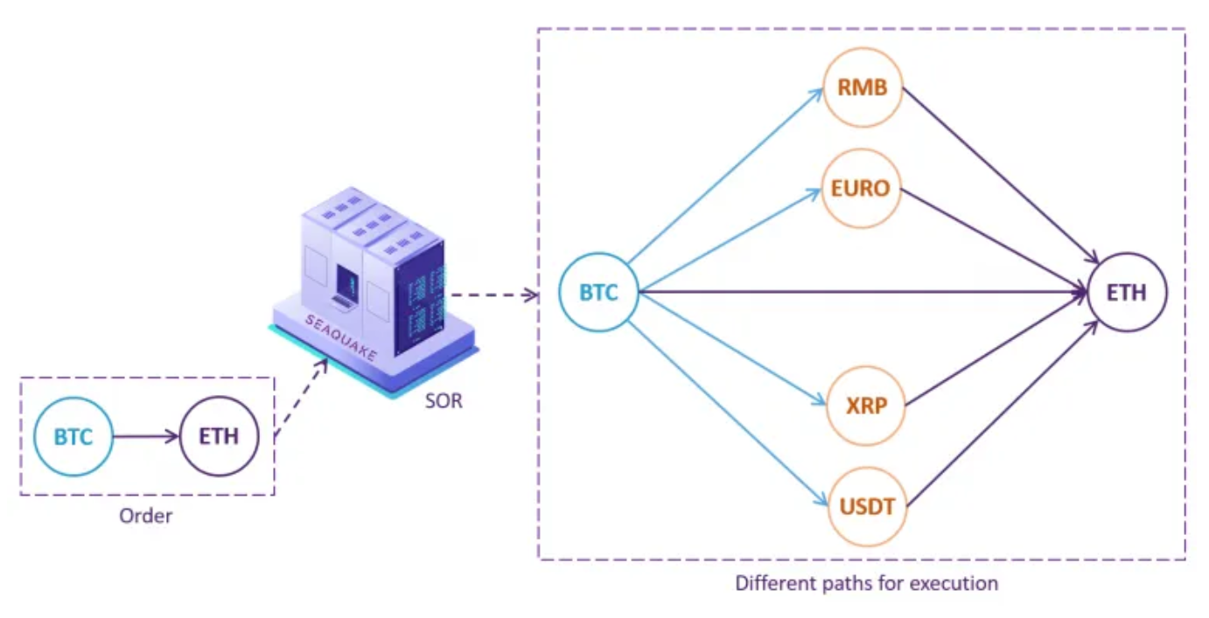
Smart Order Routing
Query DEXs through APIs or smart contracts for
Swapping rates
Fees (Gas, Swapping)
Liquidity pools
Token Pairs
Convert DEX data into a graph
Nodes are the DEX token pairs, and liquidity pools
Edges are from each token to their respective pools
Weighted by the queried data for each dex
Solve the graph problem
Find shortest path
Execute all transactions

Slide 19
Difficulties with DEX Aggregator
SOR
DEX Query
Gas Cost
Use of Liquidity
DEX Aggregators have their own smart order routing. Hard to find a good algorithm
DEXs all have different documentation and does not have a universal interface
Gas costs can be higher than using a single DEX since it must compute a lot more data.
DEXs have different ways of using liquidity. e.g. Uniswap v2 vs Uniswap v3

Slide 20

IMPLEMENTATION

Slide 21
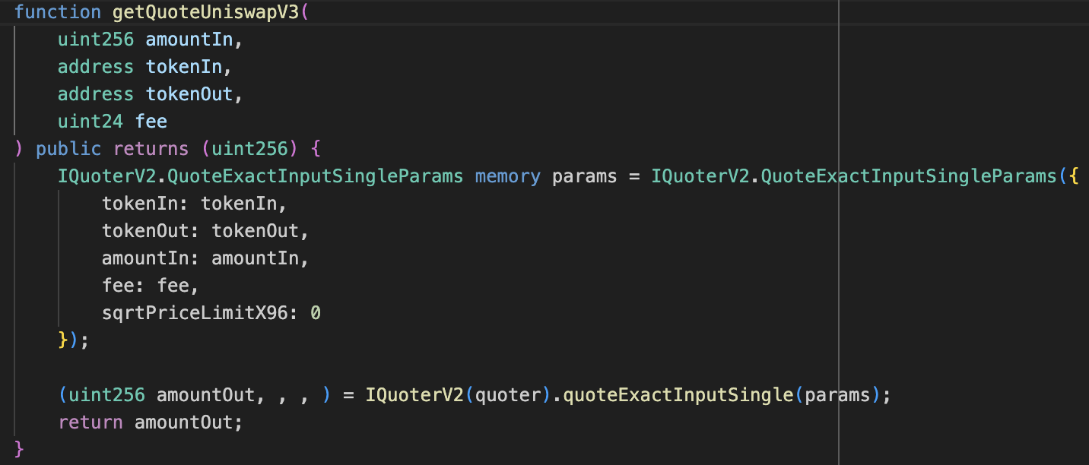

Slide 22
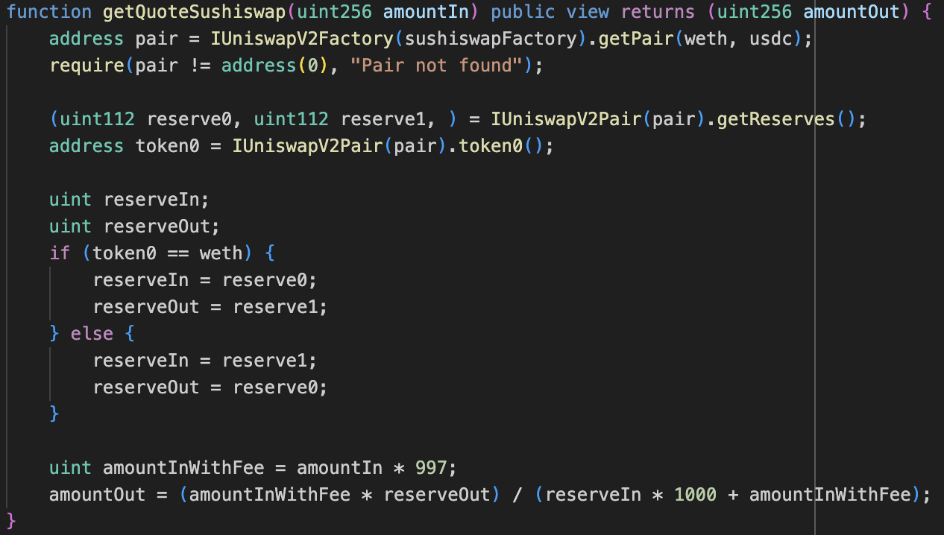

Slide 23

Contract

Slide 24
FRONTEND

Slide 25

THANKS!
Do you have any questions?

